Slide 1


Bank of Baroda Hackathon - 2022
Technology Partner
Your Team Name : CookieMan
Date : 03/09/2022

Slide 2
Problem Statement? Automated cheque processing
Why did you decide to solve this Problem statement?
Magnetic ink character recognition(MICR) technology currently used in cheque processing is expensive and slow
System can be quite overwhelming to adopt
It is very error prone
Lot of man power is wasted in the current cheque processing
Handwriting and format is non flexible currently
Higher risk and chance of fraud
Cheque searching and accessing is slow

Slide 3
User Segment & Pain Points
Which user /advertiser segment would be early adopter of your product & why?
The drawer
The drawee
The payee
Teller
Clearing house center
Accountant

Slide 4
Pre-Requisite
What are the alternatives/competitive products for the problem you are solving?
PENTAchecks: Integrated, Enterprise Form and Check Processing Software (US)
FincraftTM Cheque Truncation System (Japan)
MicroAquire (US)
Capitaliz (USA)

Slide 5
Azure tools or resources
Azure tools or resources which are likely to be used by you for the prototype, if your idea gets selected
Cloudmonix:
Serviced by Paraleap Technologies, LLC
Parent organization: Netreo, Inc.
It is a 3rd-Party Software that Increases operational efficiency through streamlined access to metrics and events with tight integrations across all the stack : Monitoring, logging, Collaboration, etc.
Computer Vision :
An AI service that analyses content in images and video. Extracts rich information from images and video, labels content with objects and concepts, extracts text, generates image descriptions, moderates content and understands people's movement in physical spaces.
Features:
Text extraction (OCR)
Extract printed and handwritten text from images and documents with mixed languages and writing styles.
Image understanding
Pull from a rich ontology of more than 10,000 concepts and objects to generate value from your visual assets.
Spatial analysis
Analyze how people move in a space in real time for occupancy count, social distancing and face mask detection.
Flexible deployment
Run Computer Vision in the cloud or on the edge, in containers.

Slide 6
Methodology
The bank cheque verification tool required fulfilment of some key stages in sequential manner. At first we must process the image to crop and produce noise free image then we verify the authenticity of the cheque by validating the cheque leaflet using security features in mandatory CTS-2010 cheque format by RBI such as :
Bank Logo in UV ink
Printer name with CTS-2010
Void Pantograph
Micro-lettering
Account Holder Name
After that , the tool ensured the genuineness of IFSC present on cheque then it verified the cheque number to ensure whether the cheque was from the set of cheque leaflets assigned to the account holder or not. After that, the amount was verified by checking whether the customer was having sufficient amount in his account for which he released the cheque, and finally the signature of the cheque issuer(s) was verified. Only after the completion of these necessary verification steps, the cheque clearance was passed for transfer or withdrawal of funds. The entire process of cheque clearance happened in a sequential manner and each step was mandatory for the next step. Different methods were used for extracting such information from the cheque leaflet that depended on the viability and level of accuracy. For example, to extract information from the machine typographic script, we use OCR method as it tends to produce results with higher level of accuracy whereas for hand-written words and numerical values, we can use deep learning based CNN. Similarly, for authenticating the signature(s), we extracted the features using CNN which produced optimum results. To implement these methods, we required noise free image therefore the better idea was to segment the image so as to acquire only the relevant information. These steps encompassed certain sub-steps each of which were essential to meet the standards so as to extract the required information from the bank cheque.

Slide 7
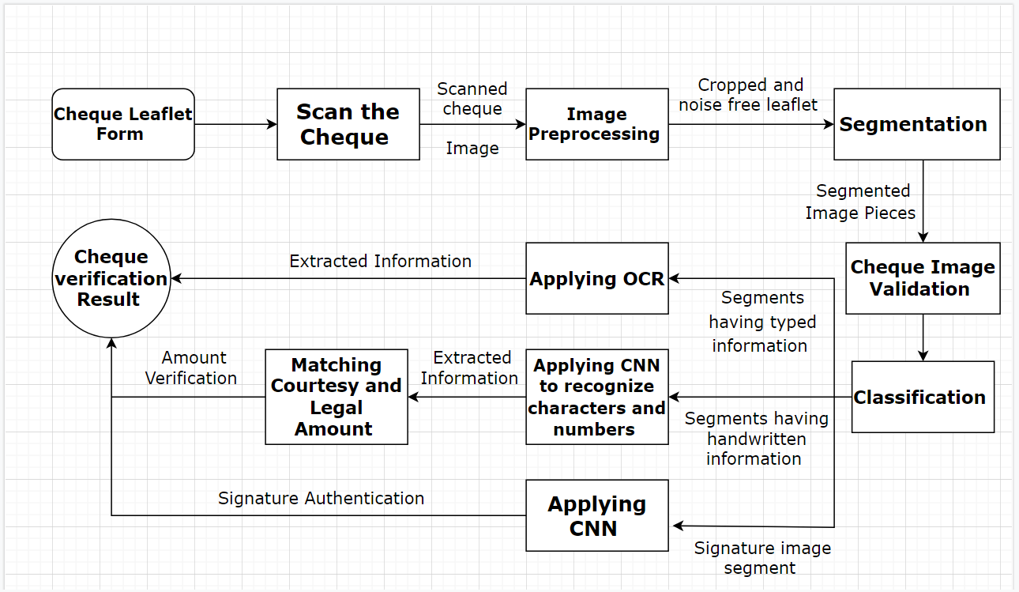
Block Diagram of Automated Cheque Processing Tool

Slide 8
Future Scope
The Algorithms and methods used to implement the automated cheque processing tool is incredibly flexible to any changes that may need to be made based on update in RBI guidelines without causing any significant decrement in the accuracy or efficiency of the originally presented model.
The model can also be updated to add new algorithms and methods that may increase its accuracy even further without having to reimplement the entire model .
GitHub Repository Link
https://github.com/Eeshan-MI7/CookieMan

Slide 9
Thank You
Team members :
Eeshan Mishra (Leader)
Dinesh Prajapati
Heet Patel

